Slide 1
DARN GOOD
ADVICE
(for digital designers in Government!)
How to do Your Best Work
By 2 “seasoned” #GCDigital Practitioners
Jérôme Foldes-Busque & Samantha Lovelace

Slide 2

1.
Remember: you are doing important work.
Welcome to a wonderful world!
The problems you will work on are some of the most complicated in the digital design field. If you can contribute to solving them, the impact will be felt all over the country, the world.
Notes:
LEAD: SAMMY
In your role as a designer in the Canadian Public Service, you have a chance to make people’s lives better. The problems you will work on are some of the most complicated in the design field. If you can contribute to solving them, the impact will be felt all over the country, the world.
Never forget this. It will keep you pushing forward.
https://www.udiscovermusic.com/wp-content/uploads/2014/07/Louis-WAWW.jpg
https://www.udiscovermusic.com/stories/louis-armstrongs-wonderful-world/

Slide 3

2.
Reach out and meet your community.
You are not alone.
Digital design in the Government of Canada can be...a little out of the ordinary, which can feel very lonely at times. But, there are great people all over the GC to support you!
Join the GC UX network, attend and A11y meet-up, reach out and grow!
Notes:
1st: SAMMY
2nd: JÉRÔME
No matter how cool your project is, how amazing your team, how excited you are to be working in this incredible space, being a designer in the Government of Canada can be lonely at times, even alienating.
But you are not alone!
There are hundreds of people working all over the government doing work just like you. There are people outside of government working on the same problems you are working on right now, but for a different department, or maybe even just a different branch. No matter what design you’re doing, what kind of challenge you’re working on, there’s people who specialize in that, who are members of communities who can support that.
We are, for some reason, terrible at joining forces and tackling our trickiest problems in a collaborative unified way, but that doesn’t mean that it isn’t possible. If you’re ever feeling alone and are in need of a second set of eyes or just a person to listen to your challenges, reach out to peers in GEDs or on linkedin, hit up one of many GC meet ups, look into specific design topics in GCcollab. Join the GC UX network, attend and A11y meet up, reach out and grow!
Get out there and come join the ranks of GCDesigners :)
JÉRÔME:
There are experts everywhere, in every department.
My areas of specialization are:
Web content
Search engines and SEO - SEO WG
Web addresses and domain names - Standard on Web Usability, Appendix B
Intranets
Web policies and accessibility
Web archeology
Photo by sydney Rae on Unsplash

Slide 4
3.
A Perspective
In the private sector, the pressure for restructuring and renewal has come from increased competitiveness and the unforgiving nature of high costs. Many argue that consumers have become more demanding as they look for better service and quality at a lower price.
For governments, the pressure is for better service in the face of reduced revenues and mounting debt. Many consumers of government services appear to have lost their tolerance for bureaucracies. They feel they receive better service from banks, car rental companies, even supermarkets, which have transformed business with innovative information technology. The government increasingly appears to be out of date. Many want to know why they have to spend their precious time finding answers to their questions, after being bounced from department to department, when sometimes (not always) it is easier to get satisfaction from customer-hungry private companies. "Why do I have to call so many places? Why do I have to wait so long? Why can't they solve my problem right here, right now?" These are questions that governments must take seriously. Government must re-invent itself, as other institutions have had to do to survive. Government must fundamentally improve the way it administers its business and delivers its services.
Notes:
LEAD: Jérôme
Blueprint for Renewing Government Services Using Information Technology - April 1994
http://www.tbs-sct.gc.ca/pubs_pol/ciopubs/tb_oimp/uit-ati/uit-ati01-eng.asp

Slide 5

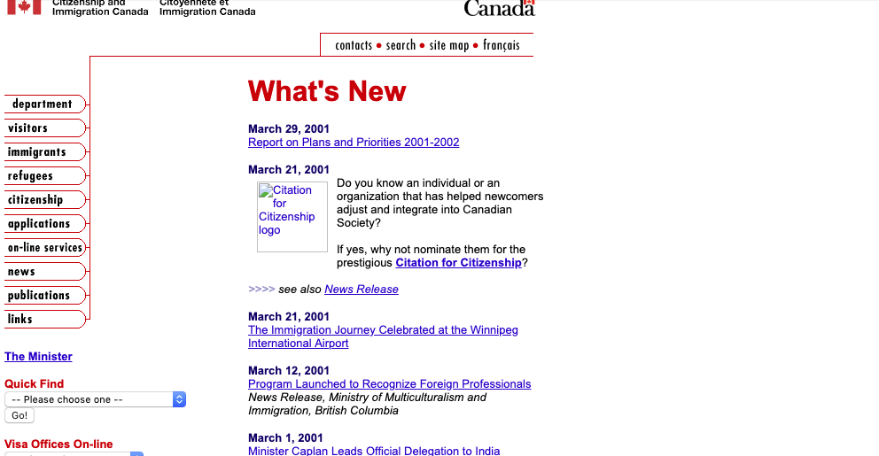
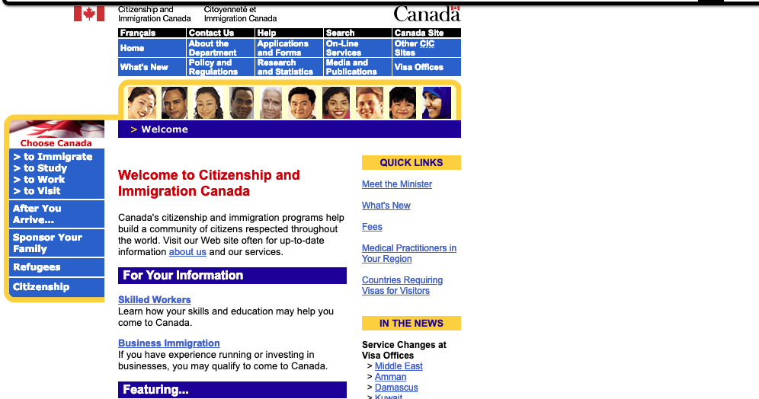
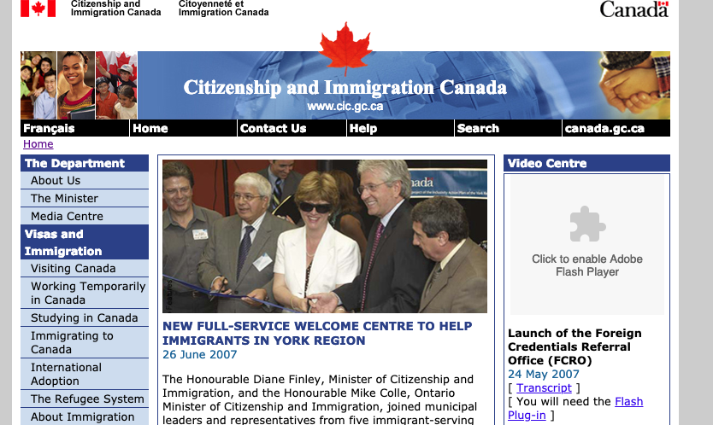
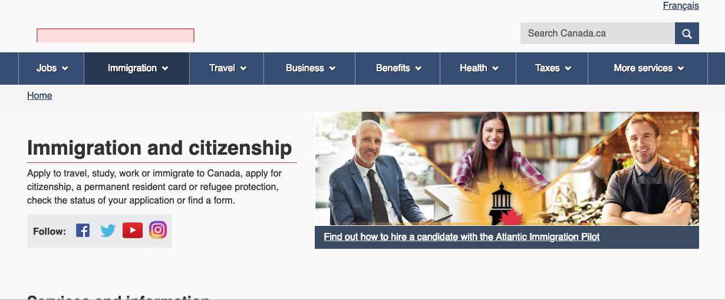
4.
Know your GC digital design history!
1996
2001
History repeats itself.
You are not the first person try cracking the trickiest of digital design challenges.
Build an understanding of what has happened in the past, so that you can overcome similar challenges in the future.
2003
2007
2014
Notes:
1st: SAMMY
2nd: JÉRÔME
The first large scale initiative to standardize the Government of Canada's presence on the Internet was launched in 1999. It was called GOL (Government online). Before then, it was a free for all.
Since then, thousands of projects have been undertaken to re-organize, re-write, re-theme, re-platform, make things easier to find, to use, improve service delivery, communications and maintain a leading edge in a highly competitive market for people’s attention.
There have been articles written about it, research done on it, standards written to support it.
Over the past 20 years, the digital interface to Government of Canada services has seen 4 major over hauls and is likely in the process of rolling out yet another in the next few years.
You are almost certainly not the first person or team member to try cracking the trickiest of digital design challenges. There is a very good chance that what you’re working today on was worked on 5, 10, 15, 20 years ago by someone else. You just need to find them.
Jérôme:
1995: 1st GC web (I started in 1993)
Many things have been tried, some good, bad, ugly or lucky
We didn't get everything we wanted
Don't upgrade or update, built new solutions. Keep what's good, discard what's bad
Forms - paper to online
Design to business goals, build digital from scratch.
Try connecting with those who worked on the previous versions. Do some web archeology
http://gouvernance.ca/publications/00-57.pdf
https://www150.statcan.gc.ca/n1/en/catalogue/56F0004M2007015 https://www150.statcan.gc.ca/n1/en/pub/56f0004m/56f0004m2007015-eng.pdf?st=KWvkWa0O
https://ottawacitizen.com/business/local-business/federal-government-prepares-biggest-refresh-of-its-web-offerings-ever
http://publications.gc.ca/collections/Collection/P4-1-2006E.pdf

Slide 6
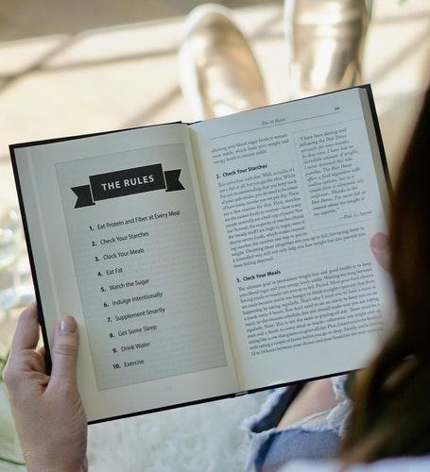
5.
GC has rules for web design, but they are just the beginning.
Standard on Web Usability
Standard on Web Accessibility
Standard on Web Interoperability
Standard on Metadata
GC Policy on Communication and Federal Identity
GC Style Guide
Common Look and Feel 1 & 2
Notes:
1st: Jérôme
2nd: SAMMY
Jérôme:
These standards are very important, but were built to help us align our designs and best practices, not to tie us up.
Some were crowdsourced, talk to the community. Please don't bash our work.
Learn what they mean, there are just the beginning. There is a lot of flexibility in those.
Be mindful of the issues and bad practices we wanted to stop.
But they only apply to public-facing Web content under the control of the GC.
Sammy:
You need to understand the rules in order to know when and how you can stretch them, how to use them to your advantage and when you just need to work in or even around them.
Understanding comes in many forms including that they exist, how they should be applied, but most importantly what they are in place to accomplish and why they were created at all. When you develop a broad and deep understanding of the rules, they become a lot more flexible.

Slide 7
6.
It’s all about “me”.
Don't make me think
Google will tell me the answer
I'm in a hurry
How can I make them care about my work?
Users should not rely on other sites for information
I want them to know about our other services
Notes:
LEAD: JÉRÔME
Jérôme:
On the web, it's always about me.
As a designer, it's too easy to make it about "me". Don't do that, after launch, it's no longer yours. Give it up!
Support the task, don't hijack it!
There's no such thing as casual browsing - we always go online with a purpose (entertainment is a purpose, knowing what others are saying is a purpose))
Google is always 1 click away. If I can't find it, it doesn't exist.
Nobody visits the home page - Only bots. (Wikipedia) Let other worry about the home page.

Slide 8
7.
Never forget about content.
Notes:
1st: JÉRÔME
2nd: SAMMY
Jérôme: Can't design without content. SSC intranet
Sammy:
Design objectives (comms, information, task completion, etc.)
Task completion
Compliance
Content drives design decision making

Slide 9
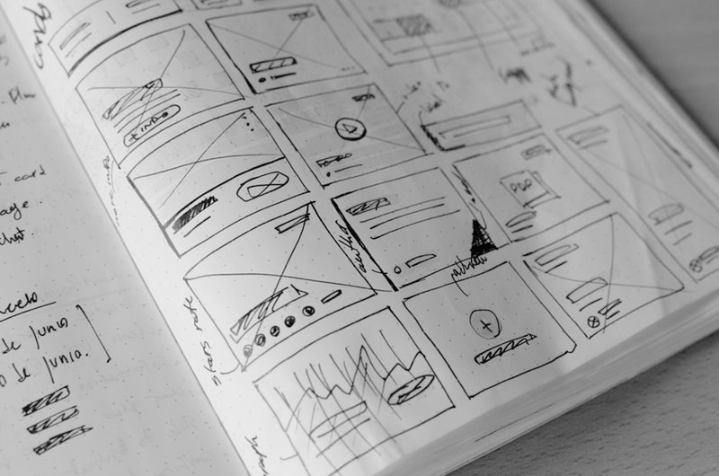
8.
You might not have the right tool, but you can still design
The tool doesn’t make the designer work, the designer makes the design.
There are many ways to get a job done, and many tools to support those approaches. Pick the tool that fits your unique context of design and do your best work with it.
But also don’t forget to put in a request for your favourite tools ;)
Notes:
LEAD: SAMMY
The tool doesn’t make the designer work, the designer makes the design.
There are many ways to get a job done, and many tools to support those approaches. Pick the tool that fits your unique context of design and do your best work with it.
A tool that is amazing today may be old news tomorrow. It doesn’t mean you can’t still mockup a page or build an information architecture, it just means you can’t do it with that tool.
But also don’t forget to put in a request for your favourite tools ;)
Photo by José Alejandro Cuffia on Unsplash

Slide 10
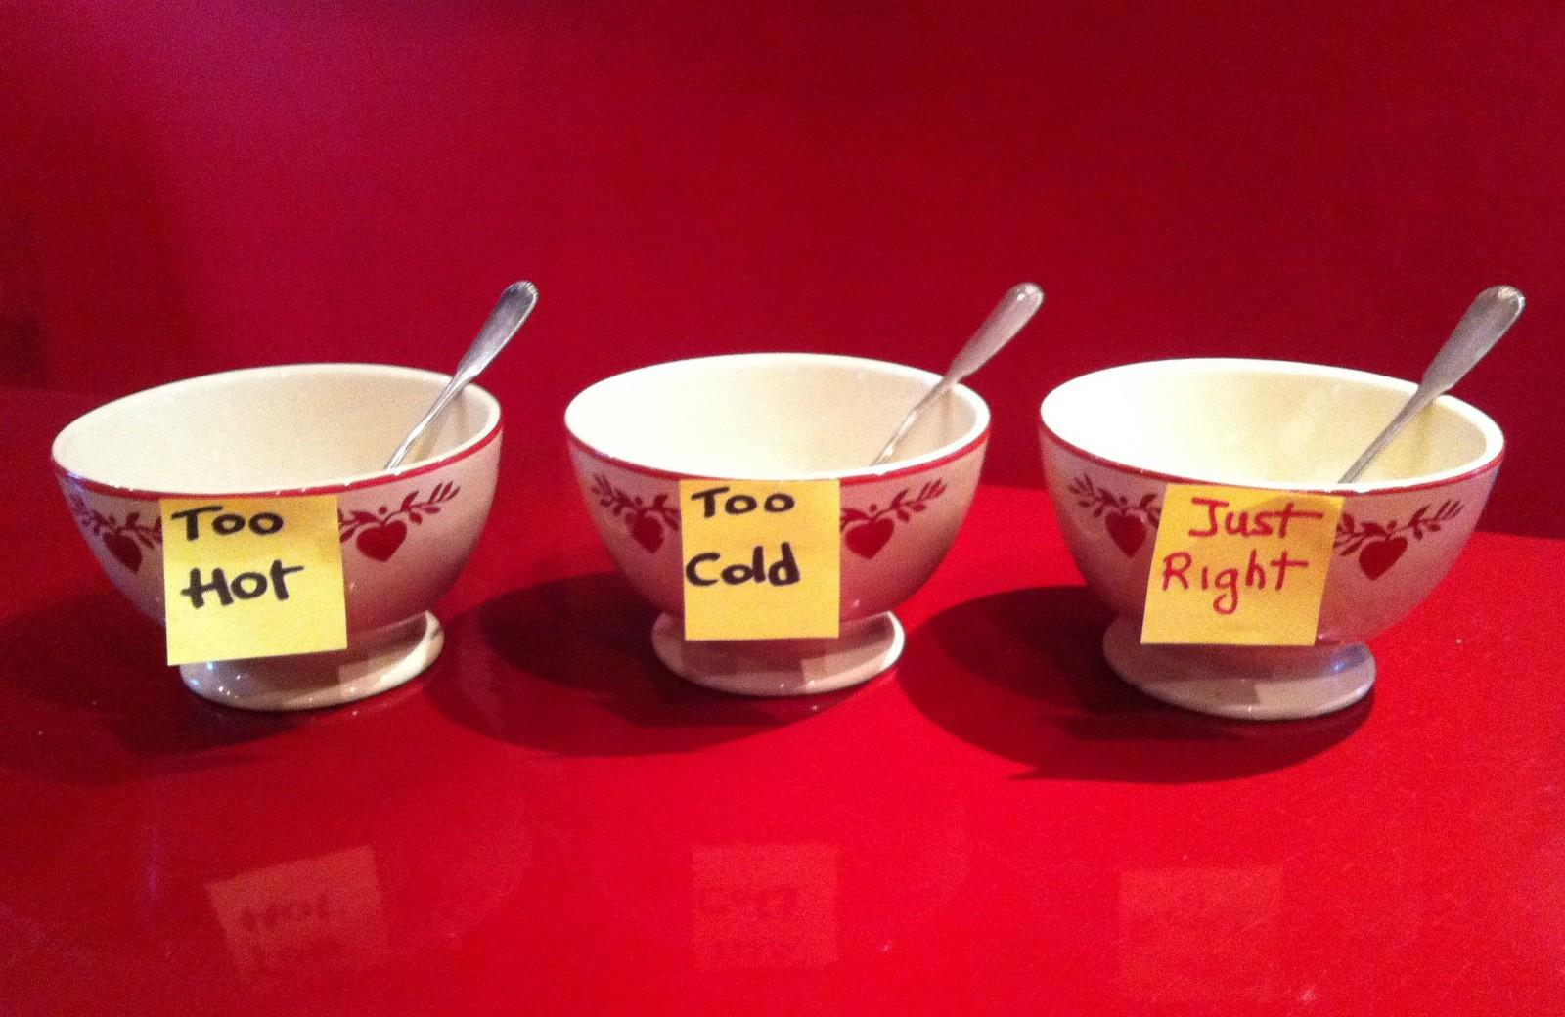
9.
Model, test, iterate, repeat.
Modeling out your concepts is an effective way to get productive, valuable feedback and validate assumptions.
But never be satisfied with the first draft. Continue to adapt and change until you’re confident that what you’re working towards is just right.
Notes:
LEAD: SAMMY
Modeling out your concepts, no matter how you build them, is one of the most effective ways to get productive, valuable feedback.
But start at the highest level. Don’t over polish or promise until you’re sure you’re on the right path.
This is especially important in times when people need something to point to that says “look at the great work we’re doing!”
Set your expectations through your models so you don’t end up needing to deliver something that isn’t possible or doesn’t fulfill its objectives.
Never be satisfied with the first draft. Continue to adapt and change based on feedback until you’re confident that what you’re working towards is just right... Then earn from it and iterate again.
https://medium.com/@CoachLesterBHS/effective-peer-feedback-or-the-third-kind-of-porridge-53b9b970ce2d

Slide 11

10.
You can find users and test anywhere.
Just because your POR team says you can’t send out that survey, doesn’t mean you can’t do user research.
Try to get feedback regularly. It will only build your confidence that what you are building is the the right thing for the people using it.
Notes:
LEAD: SAMMY
Just because your POR team says you can’t send out that survey, doesn’t mean you can’t do user research and testing. We don't actually want opinions, we want to know what people do, how they use our products, tools, services...
Any time you are sharing your idea with a person who uses digital tools, you will learn a lot about how people might use your design. Whether it’s a colleague, a specialist, a stranger on the street or an real, honest to goodness, digital service user, the more information you have the stronger your confidence will be that what you’re building is right.
Get feedback. Get feedback regularly. And never stop trying to strengthen your confidence that the work you are doing is the right thing for the people using it.
Photo by Igor Miske on Unsplash

Slide 12

11.
Share your work!
Document your processes, share your sources, illustrate your design decisions, post your prototypes!
This will help you gather feedback on your designs, help your peers make better, faster decisions, reduce the burden of findability and tell a great story.
Notes:
LEAD: Jerome
Consulted openly for UXWG on GCPedia
WxT Github
CDS Medium
GCLeaders Twitter
OneGC Collab
GC UX Network
etc.
Document your processes, design approaches and decisions, your recommendations and your results!
We are notoriously bad at sharing stories of our work across the government (departments, branches, divisions, teams, cliques! We’re just bad at sharing overall). We share updates, pictures, we present at conferences, but there is rarely, if any record of initiatives and all of their nitty gritty details available at the click of a mouse.
Some teams do it well, but it’s inconsistent across Government.
So share your work! This will help other GCDesigners just like you, will help you find your community and, if everyone does it, help you learn too!
https://github.com/

Slide 13

12.
Loosen up your traditional design processes.
The Government of Canada is changing and digital design is changing (even though it may feel like it just got started).
The future of GCDigital is
Digital design Agile.
Notes:
1st: SAMMY
2nd: Jérôme
The Government of CAnada is trying to change how it delivers digital services and part of that change includes designing in the context of Agile.
To survive as a designer in this new world, you have to loosen up traditional processes and be flexible with workflow, methods and methodologies.
Try it out, gather results, learn from your sprints, try something new! Figure out how you fit and how you need to change to get your work done.
It’s fun, but it will take a little getting used to. You have to learn, experiment, iterate and build agile muscles, just as you would with any design skill.
Oh! And if you don’t take any other advice away from today, get formal training! It’s worth every penny!
JÉRÔME:
Agile is good for your little designer "me", as it allows you to get more over a longer period of time.
No need to argue as much about design elements
You just have to be patient

Slide 14
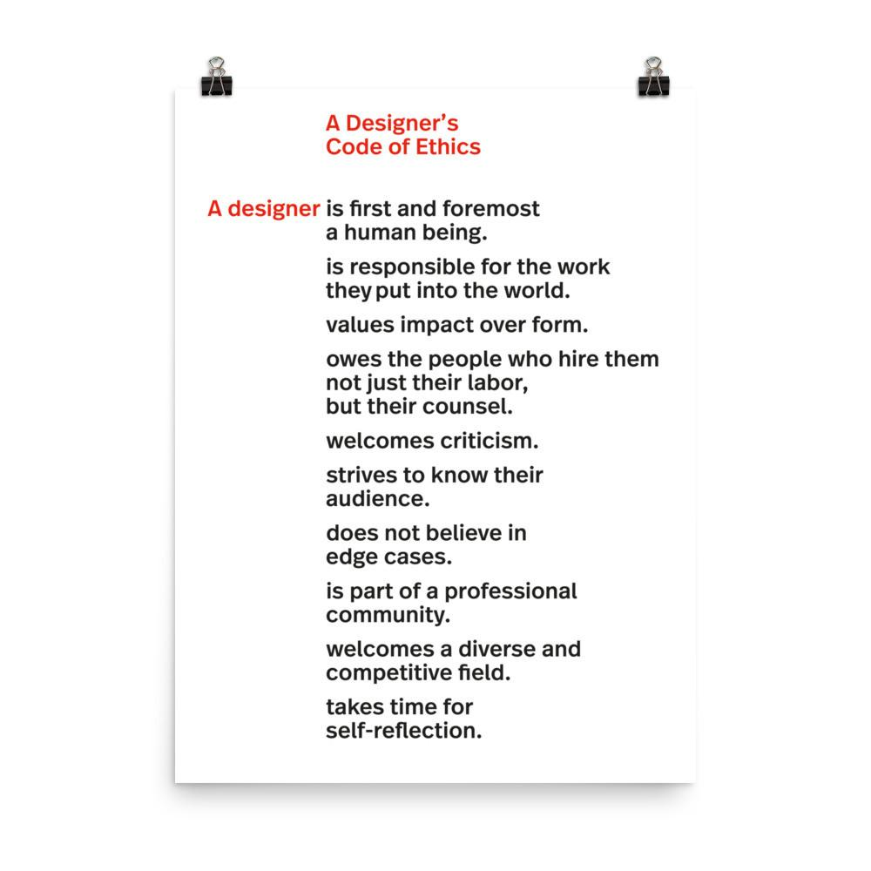
13.
Use your powers for good.
Designers have ethics to adhere to.
As a member of this community you have a responsibility to ensure that your powers are used for the good of the people using your things.
Notes:
1st: SAMMY
2nd: Jérôme
Whether you know it or not, designers have ethics to adhere to.
No matter if you are an industrial designer, a UX designer, graphic designer, or a person planning the service strategy, you are a DESIGNER. As a member of this community you have a responsibility to ensure that your powers are used for the good of the people using your things.
Please review, understand and make sure you design to the highest ethical standards and work to only ever improve the experiences of GC Digital users. Do not use your powers for evil.
JÉRÔME:
SEO and click bait
Link to accessibility, Good design is both accessible and usable.
Design for everyone, even for those who our colleagues don't think exist.
Google is the biggest blind user with a learning disability
https://muledesign.com/2017/07/a-designers-code-of-ethics
https://cdn.shopify.com/s/files/1/2220/7763/products/mockup-a11b831a_1296x.jpg?v=1501767600
https://designtherightthing.com/collections/frontpage

Slide 15

14.
Small wins matter. Don’t forget to celebrate them.
No matter how well researched your design is. How beautifully tight it is. How well it tests...It will never look or work exactly the same as you’d originally planned.
To stay sane you need to be able to find one little thing to celebrate in everything you worked on that releases.
Notes:
1st: SAMMY
2nd: Jérôme
Examples of successful design that weren't implemented or that weren't recognized
If you ever get to release a full design end to end, exactly as planned, you deserve a medal!
In your career as a designer in the GC, even as a designer in the private sector, your work will be man handled, ripped apart, put back together, reorganized, redesigned, someone else will take credit, and you will hear “no” a bunch of times during the process.
To stay sane, though, you need to be able to find one little thing to celebrate in everything you worked on. Otherwise you will go crazy.
For me, it was having the Government of Canada logo in the upper left hand corner link to the home page. Small wins. :)
PS. I’m still sad that this wasn’t the wordmark. It would have been majestic!
Jérôme:
SEO successes
Life events

Slide 16
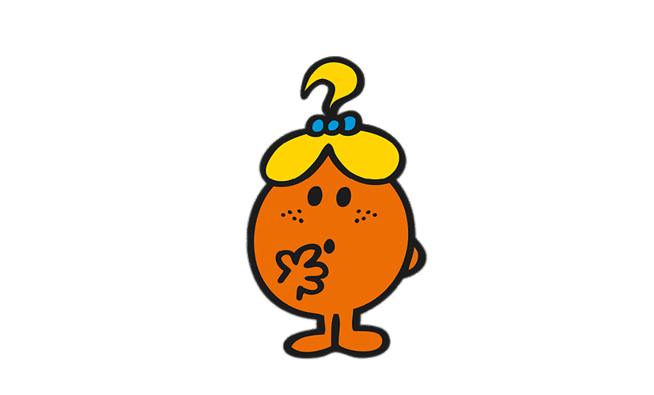
15.
Be curious. Be brave.
None of this is easy, but if you remember that you are doing the important work, you will find a way forward.
Never stop exploring and stand tall! You are doing a great job.
Notes:
LEAD: SAMMY
None of this is easy, but if you remember that you are doing the important work, you will find a way forward.
Use push back as an opportunity to explore how to present better, use meetings tell your colleagues what you do. Stand up for the practices you have learned to be best and adhere to your designerly values. It is hard, and people won’t always be happy with what you do, but know that the only way forward is to increase expectations, and set the bar higher, to continually evolve and be strong in your resolve to design the right services for users and the government alike.
http://www.stickpng.com/assets/images/58afd5f80187e59a7d8a8f0b.png

Slide 17
16.
You know you have succeeded when they say..."That's it???"
¯\_(ツ)_/¯
Notes:
1st: Jérôme
2nd: SAMMY
Simona
http://www.stickpng.com/assets/images/58afd5f80187e59a7d8a8f0b.png

Slide 18

Bonus!
When you feel stuck, pick up a book ;)
We got our inspiration for this presentation from George Lois’ book: Damn good advice for people with Talent.
You should get the book. It’s awesome!
Notes:
1st: SAMMY
2nd: Jérôme
We got out inspiration for this presentation from George Lois’ book: Damn good advice for people with Talent.
It’s an inspirational read that I picked off my coffee table over the weekend to try and get motivated to push through a tricky challenge.
I hope this presentation has the same effect for you (though, you should get the book...it’s wayyyyyyyyy better).
JÉRÔME: Just reach out on twitter
https://ca.phaidon.com/store/general-non-fiction/damn-good-advice-for-people-with-talent-9780714863481/
http://www.phaidon.com/resource/9780714863481.jpg

